Slide 1
Standard operating plan
Analyze the problem
Implementation of countermeasures
Current situation analysis
standardization
Selected topic
478/479 series COVER
Packer work standard case
Department : Secondary Molding Department
system Author : Wang Zhonggui
counselor : Shi Minghui
Promotion date : 11/20.08
Project number : SICSMPBM451081101
REV:B
Approved by: Liang YuanlongChecked by: Ruan Yuanlong

Slide 2
Project proposal review

Slide 3
Project proposal review

Slide 4
Analyze the problem
Implementation of countermeasures
Current situation analysis
Start
standardization
Selected topic
Selected topic
List job responsibilities
List jobs according to organizational structure
Position and corresponding job responsibilities
Select topic
1. Project evaluation to determine priorities
2. Select a topic
3. Define indicators and measurement methods
1. Determine the workflow and order of operations
2. Develop a data collection plan and confirm
Working time
3. Calculate indicators and set goals
set goals
Develop implementation
plan
1. Implementation schedule planning
2. Project review
Current situation analysis

Slide 5
Standard work progress
Key message: All existing personnel in the inventory department have standard operations, among which packers account for 66% of the total production staff, which is the focus of further analysis and improvement.

Slide 6
Select topic
1. Job evaluation and selection of topics
Key message: Based on the comprehensive evaluation of work saturation, number of personnel, and improvement results, the NB478/479 series COVER packer standard operations were selected as this promotion project

Slide 7
set goals
1. Determine the work process , operation sequence and operation time
478/479 Series COVER Packaging Post FLOWCHART
Summary: The current manpower configuration is 2 people and 3 machines. The time to complete a cycle is 2800 S. The work saturation is 64.81%. The saturation is low and needs further analysis and improvement.

Slide 8
Select topic
1. Define indicators and measurement methods
Operator cycle time
=
2800(sec/box)
=
A. Job saturation =
takt time
64.81%
4320(sec/box )
B.UPPH
UPH
13438pcs /H
=
=
=
896( pcs/H/ person)
Number of workers
15 people
=
actual output on shift
=
107500 pcs
=
13438pcs /H
UPH
Working hours on duty
8 H
The output of two shifts is: 215 K
2. Set goals

Slide 9
Select topic
1. Define indicators and measurement methods
Operator cycle time
=
2800(sec/box)
=
A. Job saturation =
takt time
64.81%
4320(sec/box )
B.UPPH
UPH
13438pcs /H
=
=
=
896( pcs/H/ person)
Number of workers
15 people
=
actual output on shift
=
107500 pcs
=
13438pcs /H
UPH
Working hours on duty
8 H
The output of two shifts is: 215 K
2. Set goals

Slide 10
Develop implementation plan
1. Implementation schedule planning

Slide 11
Analyze the problem
Implementation of countermeasures
Current situation analysis
standardization
Selected topic
Current situation analysis
Develop standard
work
1. Determine the type of job
2. Develop standard books
1. Process capability and value analysis
2. Saturation and efficiency analysis
3. Layout and logistics analysis
4. Screen projects for improvement
Current situation
analysis
1. Improve items that can be improved immediately
2. Manpower structure adjustment
3. Standard book update and execution
Implement improved
project management
Analyze the problem

Slide 12
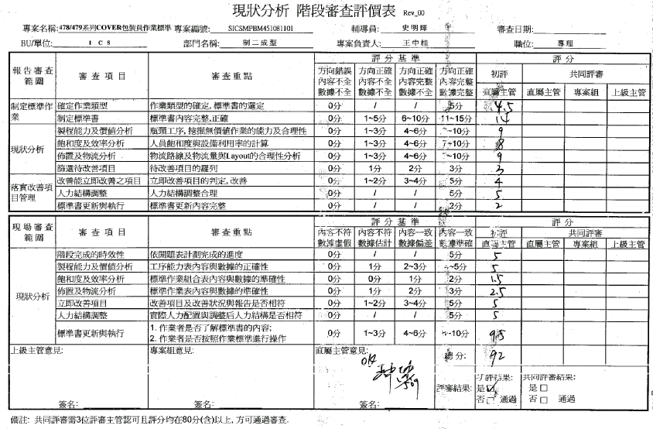
project review

Slide 13
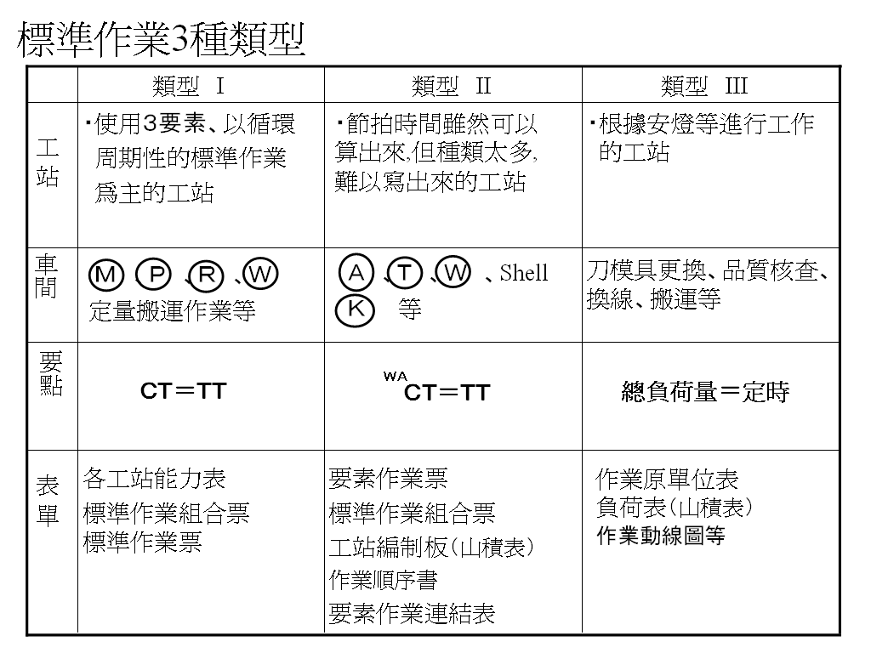
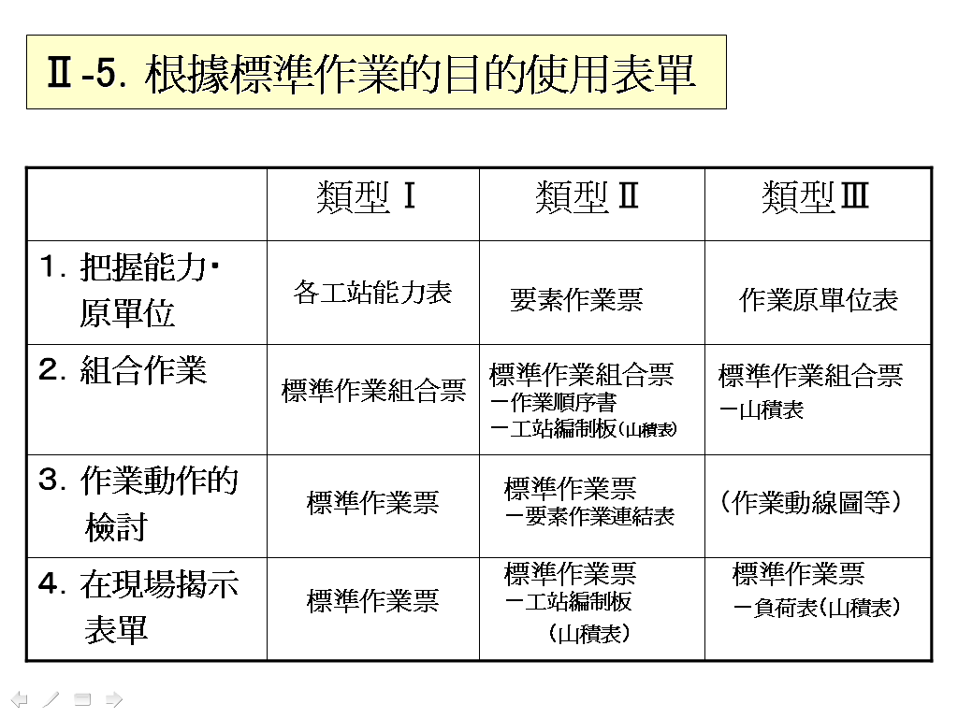
Develop standard operating documents
1. Determine standard job types
Summary :
1: Taking the work of packers as the research object
2: Packers have the characteristics of repetitive and sequential operations
3: Packer saturation can be measured using beat time
In summary, this case has the characteristics of the three standard elements and complies with Type I

Slide 14
Prepare standard work book
2. Current operating specifications
Summary: The current working time is 4200 S. One person packs 1.5 machines (1.5 boxes of products), two people and three machines form a cycle.

Slide 15
Current situation analysis
1. Process capability analysis
Summary : 1. Among the 16 workstations in the total process, the master mold surface inspection takes the longest , and its processing capacity is 18 barrels (1 k/ barrel)
2. The master mold surface inspection and rod threading operation time accounts for 3840 sec/4192*100%=91.6% of the total cycle operation, and subsequent key improvement processes are required .

Slide 16
Current situation analysis
1. Process capability analysis
Summary : 1. Among the 16 workstations in the total process, the master mold surface inspection takes the longest , and its processing capacity is 18 barrels (1 k/ barrel)
2. The master mold surface inspection and rod threading operation time accounts for 3840 sec/4192*100%=91.6% of the total cycle operation, and subsequent key improvement processes are required .

Slide 17
Current situation analysis
2 Value Analysis
Summary:
1. The demand for packaging auxiliary materials can be improved immediately through on-site management
2. Hardware inspection & master mold surface inspection & rod penetration cannot be improved immediately,
and must be further analyzed and improved through technical development and introduction of fixtures.

Slide 18
Current situation analysis
3. Analysis of standard work combination table
1. Personnel saturation = 4200 (seconds) / 4320 (seconds ) *100% =97.22% (2 people and 3 machines saturation)
2. The continuous operation utilization rate of the machine is 100%
3. The master mold surface inspection & rod threading operation takes the longest time, and the rationality of the process needs further analysis.

Slide 19
Current situation analysis
4. Analysis of standard work combination table

Slide 20
Current situation analysis
4. Analysis of standard work combination table

Slide 21
Current situation analysis
5. Standard worksheet
Summary :
1: Layout is reasonably arranged
2: Reasonable personnel movement routes
3: T/T is 4320 sec/ barrel, C/T is 4200 sec/ barrel, one packer can complete the operation of 1.5 machines in one cycle

Slide 22
Current situation analysis
6. Layout and logistics analysis
Key message:
The layout layout is relatively reasonable, and the walking distance of personnel is the shortest. Considering the issues of material
mixing and correspondence with the assembly line, item 5 will not be improved for the time being. Item 12 requires further analysis.

Slide 23
Implement improved project management
1. Improve post- process capabilities
Summary :
1. The master mold surface inspection takes the longest time, and its processing capacity is 18 barrels (1 k/ barrel)
2: The operation steps were shortened from 16 steps to 14 steps after improvement.
3: The cycle time ( C/T) was improved from 4200 sec to 4186 sec, a decrease of 0.33%.
4. The master mold surface inspection and rod threading operation time accounts for 3840 sec/4186*100%=91.7% of
the total cycle operation, and subsequent key improvement processes are required .

Slide 24
Implement improved project management
1. Improve post- process capabilities
Summary :
1. The master mold surface inspection takes the longest time, and its processing capacity is 18 barrels (1 k/ barrel)
2: The operation steps were shortened from 16 steps to 14 steps after improvement.
3: The cycle time ( C/T) was improved from 4200 sec to 4186 sec, a decrease of 0.33%.
4. The master mold surface inspection and rod threading operation time accounts for 3840 sec/4186*100%=91.7% of
the total cycle operation, and subsequent key improvement processes are required .

Slide 25
Implement improved project management
2. Improved job combination list
Immediate improvements improve post-project cycle times
1. Staff saturation dropped from 97.22% to 4186 (seconds)/4320 (seconds ) *100% =96.9%, down 0.33%
2. The continuous operation utilization rate of the machine is 100%, and the staff saturation rate is 96.9%. The operation process still needs to be further improved.

Slide 26
Implement improved project management
2. Improved job combination list
Immediate improvements improve post-project cycle times
1. Staff saturation dropped from 97.22% to 4186 (seconds)/4320 (seconds ) *100% =96.9%, down 0.33%
2. The continuous operation utilization rate of the machine is 100%, and the staff saturation rate is 96.9%. The operation process still needs to be further improved.

Slide 27
Implement improved project management
2. Improved job combination list
Immediate improvements improve post-project cycle times
1. Staff saturation dropped from 97.22% to 4186 (seconds)/4320 (seconds ) *100% =96.9%, down 0.33%
2. The continuous operation utilization rate of the machine is 100%, and the staff saturation rate is 96.9%. The operation process still needs to be further improved.

Slide 28
Implement improved project management
3. Standard worksheet
Summary : T/T is 4320 sec/ barrel, C/T is 4186 sec/ barrel, one packer can
complete the operation of 1.5 machines in one cycle

Slide 29
Implement improved project management
4. Standard book update and execution
1. The standard operating time S/T is reduced from 4200 sec to 4186 sec, DOWN range: 0.33%.
2. Control the current situation through immediate improvement and re-establish standardized documents, and implement new standards through education, training and assessment.

Slide 30
Implement improved project management
5. Manpower structure adjustment
Note:
1 box=1000 pcs
5.1. Saturation comparison:
Standard time of packaging operation before improvement ( S/T) =4202 (seconds/1.5 boxes), saturation is: 4200/4320*100%=97.22%
After improvement, the standard time of packaging operation ( S/T) =4186 (seconds/1.5 boxes), the saturation is: 4186/4320*100%=96.9%
5.2. Manpower structure adjustment
Through the improvement of the immediate improvement project, the operator saturation level has been reduced from 97.22% to 96.9%. The labor intensity has been reduced, but the saturation level is still very high. It needs to be continued to improve before making adjustments to the manpower structure.
(Note: The introduction of fixtures is currently being used to improve the work process. The details will be introduced in the problem analysis and countermeasure implementation stage)

Slide 31
Analyze the problem
Implementation of countermeasures
Current situation analysis
standardization
Selected topic
Analyze the problem
1. For items that cannot be improved immediately ,
Carry out work breakdown
2. Analyze and find the real cause
Process analysis / operation analysis / action analysis /
Handling Analysis / 55 Method
Flow chart / human-machine operation chart
job analysis
Implementation of countermeasures

Slide 32
Analyze the problem
1. Analyze items that cannot be improved immediately

Slide 33
Analyze the problem
1. Analyze items that cannot be improved immediately

Slide 34
Analyze the problem
2. Summary of real causes
Filter out the following KPIVs by Plato/ CE Moments :
above KPIV will be included in the next phase for long-term improvement.

Slide 35
Analyze the problem
2. Summary of real causes
Filter out the following KPIVs by Plato/ CE Moments :
above KPIV will be included in the next phase for long-term improvement.

Slide 36
Analyze the problem
3. Effect estimation:
It is expected that after the completion of the long-term improvement project, the standard operating
time will be reduced from 4193 sec to 1739 sec, Down58.5%

Slide 37
Analyze the problem
Implementation of countermeasures
Current situation analysis
standardization
Selected topic
Implementation of countermeasures
Propose improvement
plans
1. Combine professional skills to propose a variety of feasible improvement plans
2. Conduct technical / economic / social feasibility assessment
Plan implementation
1. Choose the right solution
2. Plan implementation
Implementation verification
1. Evaluate the implementation effect of the plan
2. Track the sustainability and long-term effects of the plan
standardization

Slide 38
Propose improvement plans
1. Propose feasible improvement plans

Slide 39
Propose improvement plans
1. Propose feasible improvement plans

Slide 40
Propose improvement plans
2. Plan selection
Summary:
1: The optimal improvement plan for product master mold surface inspection is:
inspect the entire product together after the product is inserted into the rod.
2: The optimal improvement plan for product hardware inspection is:
merge it with the master mold inspection simultaneously & set up a variable mold core to prevent missing hardware.
3: The optimal improvement plan for product threading is: adding fixtures to replace manual alignment

Slide 41
Propose improvement plans
2. Plan selection
Summary:
1: The optimal improvement plan for product master mold surface inspection is:
inspect the entire product together after the product is inserted into the rod.
2: The optimal improvement plan for product hardware inspection is:
merge it with the master mold inspection simultaneously & set up a variable mold core to prevent missing hardware.
3: The optimal improvement plan for product threading is: adding fixtures to replace manual alignment

Slide 42
Plan implementation
3. Plan execution

Slide 43
Plan implementation
3. Plan execution

Slide 44
Plan implementation
4. Adjustment of operating procedures
Summary : 1: The improved operation process time is 2319 sec, which is (4193-2319)/4193*100%=44.69% lower than before improvement.
2: The operation process has been reduced from 16 steps to 14 steps before improvement.

Slide 45
Project goal achieved
5. Review the improvement results of the project
Achievement status of manpower reduction:
Down44.8%
Achieve packaging operations with one person and two machines,
The required packaging manpower is:
Manpower for two shifts = number of machines = 16 people
Down17.2%
Saturation achieved status:
Operator cycle time
takt time
2319s​
=
*100% =
80.52%
2880s
Per capita production capacity achievement status:
UP 55.3%
UPPH
UPH
26876pcs /H
=
=
16 people
=1680 pcs/H/ person
Number of workers
Summary: The predetermined goal is to increase the per capita production capacity by 20%
and streamline the manpower by 20%. The actual manpower is streamlined by 44.8%
& the per capita production capacity is increased by 55.3%. The goal is achieved.

Slide 46
Efficacy calculation
6. Trial calculation of asset performance
The investment cost recovery period of this project is 33 days .
It is expected that the completion of this project will generate annual benefits of 254 (million NTD)

Slide 47
Efficacy calculation
6. Trial calculation of asset performance
The investment cost recovery period of this project is 33 days .
It is expected that the completion of this project will generate annual benefits of 254 (million NTD)

Slide 48
Analyze the problem
Implementation of countermeasures
Current situation analysis
standardization
Selected topic
standardization
Develop standard book
1. Update / formulate standard operating documents
2. Manpower structure adjustment
included in control
1. The standard book is released to relevant personnel and implemented
2. Included in executive control
Project summary
1. Review the improvement results of the project
2. Summarize the improvement process
Close

Slide 49
Develop standard operating documents
1. Update / formulate standard operating documents

Slide 50
Develop standard operating documents
2. Update / formulate process capabilities
Summary :
1. The master mold surface inspection has been improved from 18 barrels (1 k/ barrel ) to 36 barrels (1 k/ barrel).
2: The operation steps are shortened from 16 steps to 14 steps before improvement
3: The cycle time ( C/T) was reduced from 4186 sec before improvement to 2319 sec, a decrease of 44.6%.

Slide 51
Develop standard operating documents
3. Update / formulate job combination list
1. Operator saturation of 1 person and 2 machines is 2319 (seconds)/2880 (seconds ) *100% =80.52%,
2. The continuous operation utilization rate of the machine is 100%

Slide 52
Develop standard operating documents
4. Update / formulate job combination list
Summary :
1: Layout is reasonably arranged
2: Reasonable personnel movement routes
3: T/T is 2880 sec/ barrel, C/T is 2319 sec/ barrel, one packer can complete the operation of 2 machines
in one cycle

Slide 53
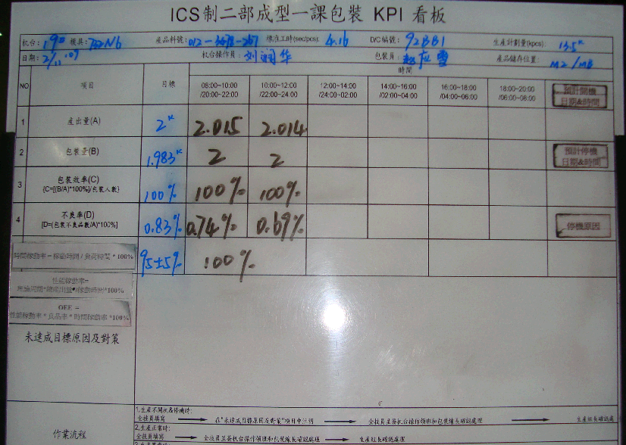
Long-term project control
5. Long-term control
The BY machine is equipped with a packaging KPI signboard, focusing on controlling the quantity
of product packaging in a fixed period of time.
2. During the BY period, the packaging line leader & production team leader will check the packaging quantity once.
If there are any abnormalities, they will be handled in accordance with the RFC in a timely manner.

Slide 54
Exception handling mechanism

Slide 55
Establish a production management manpower
trial calculation system
The number of people needed per day can be calculated based on the operator's standard working time ( ST) and the monthly product plan volume.
Taking March as an example, 15 machines were started, and the manpower required for packaging in two shifts was 16 people.

Slide 56
Education and training

Slide 57

Thanks
Eliminate waste
++
Solve the root problem
+
employee morale
+
Reasonable employment of people and machines
+
Stable and standard process
+++

